Slide 1
Satellite monitoring, transport management and analytics
An overview of the capabilities

Slide 2
SCOUT System operation principle
Navigation satellite
Data storage server
Monitoring module
Managers
МТ-700 satellite monitoring modules are installed on a vehicle
The data from those modules gets to a server and is then processed by «SCOUT-Platform» software
Software includes a detailed reports system. It allows to analyze the incoming data and make competent management decisions efficiently

Slide 3
Solutions
SD
Safe driving
FC
Fuel control
Tachograph integration
TI
BM
SMC
Special machinery control
Fueler control
FC
SVS
Stolen vehicle
search

Slide 4
Where are my vehicles?
Solution: Basic monitoring

Slide 5
Implementation benefits
from 10 to 40%
Mileage reduction
over 30%
dispatch and logistics efficiency increase
up to 15%
vehicle fleet maintenance expenses reduction
from 5 to 10%
fuel expenses reduction
Payback period: 3 – 12 month

Slide 6
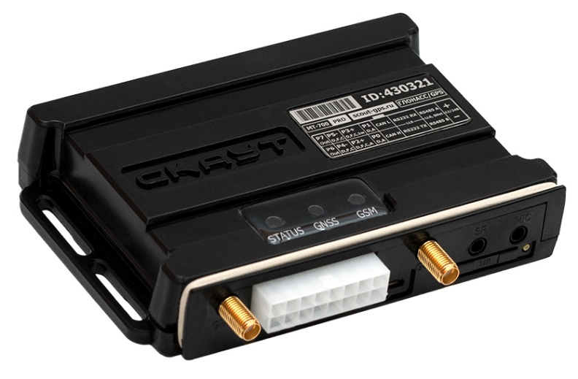
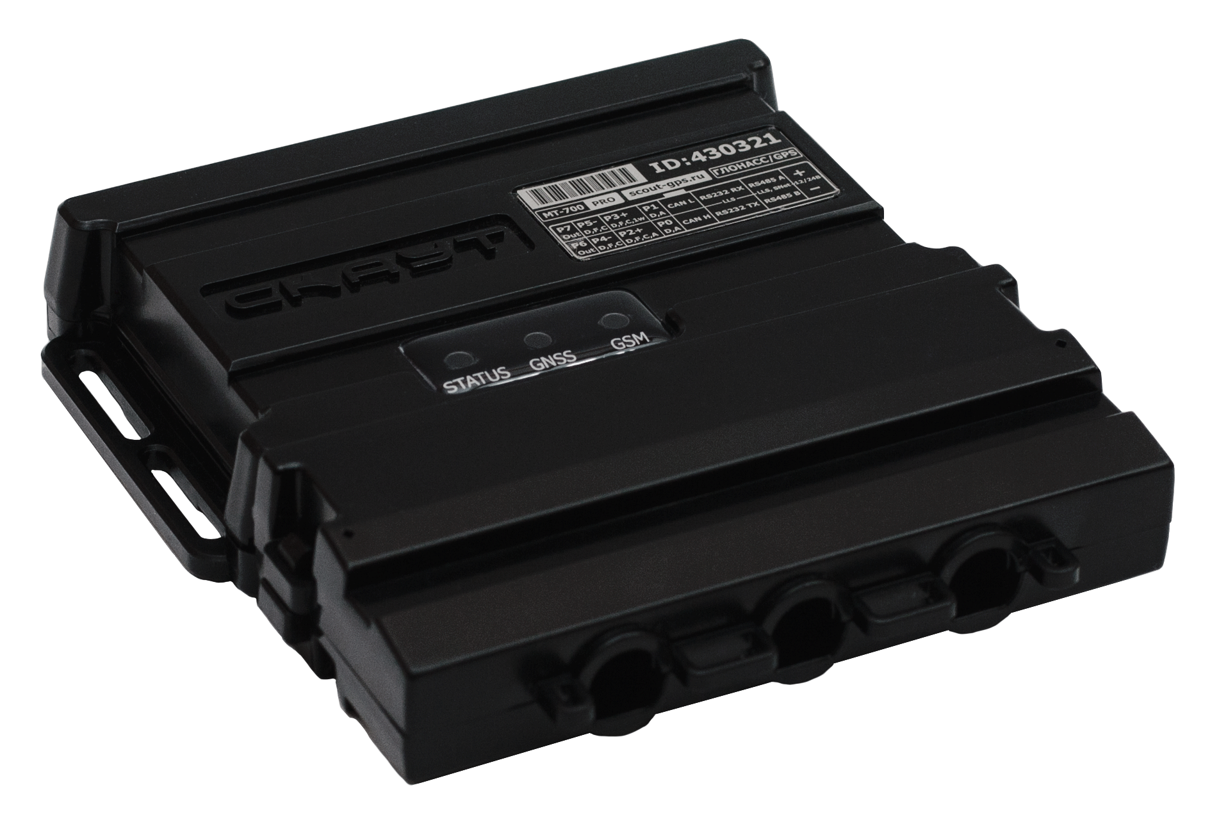
Equipment: monitoring modules
5-YEAR WARRANTY
High protection class from technogenic and climatic impacts
Installation simplicity, usability and accuracy of all parameters control
Decreased risk of a sabotage due to plugs’ isolated accommodation
Two indicators of a case violation: under the plugs cover and the main cover
Accessibility of integrating with taphographic equipment

Slide 7

Professional dispatch interface
TECH CONTROL LEVELS:
Objects control in real time
Objects’ movement data monitoring (on-map tracks)
Receiving of group and individual reports
Automatic and scheduled reports sending on email, configured events notifications

Slide 8
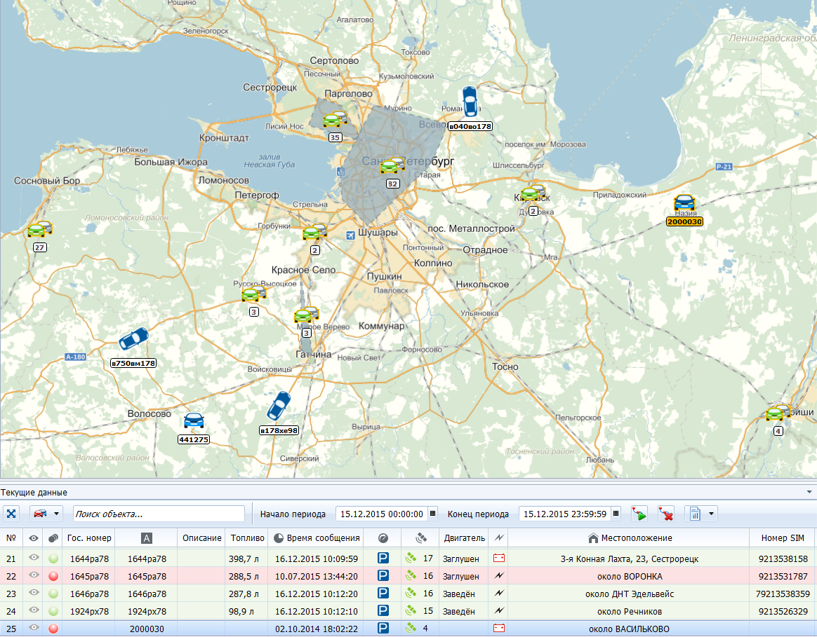
First level of control
Current location control
Sensors’ condition monitoring
Grouping objects on map
More than 30 types of maps

Slide 9
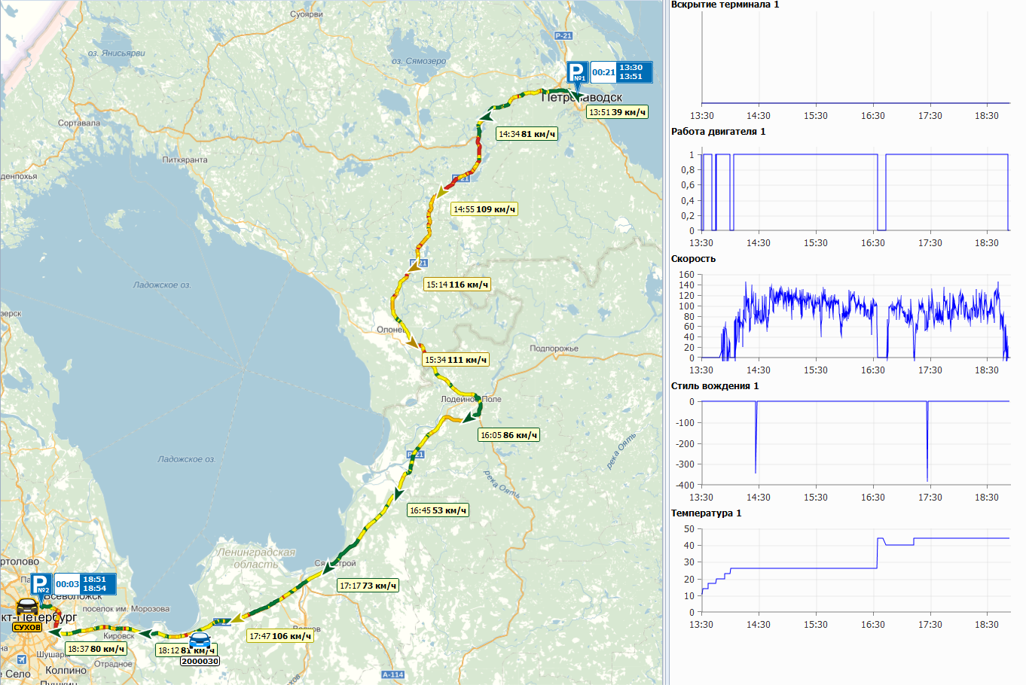
Second level of control
Movement history on a map
Stops location
Speed limits on each part of a road
Accessibility of making multiple tracks
Additional sensors’ readings graphs review

Slide 10
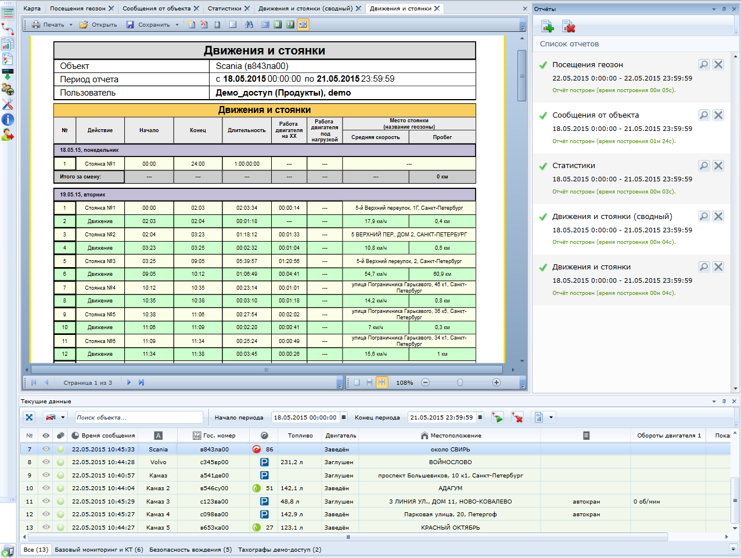
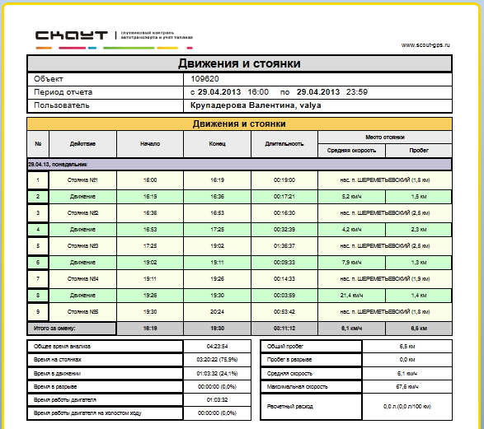

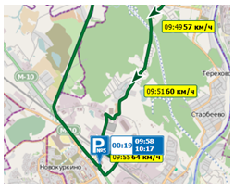
Third level of control
More than 15 types of reports
Accessibility of making individually configured reports
Saving reports in a template
Group reports on entire vehicle fleet or on a group of vehicles
Switching from group reports to single or to a map in 1 click

Slide 11
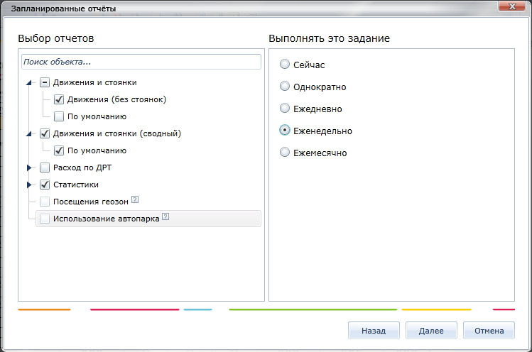
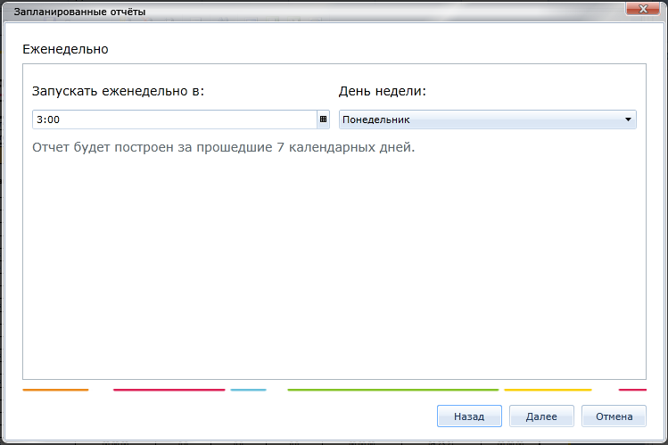
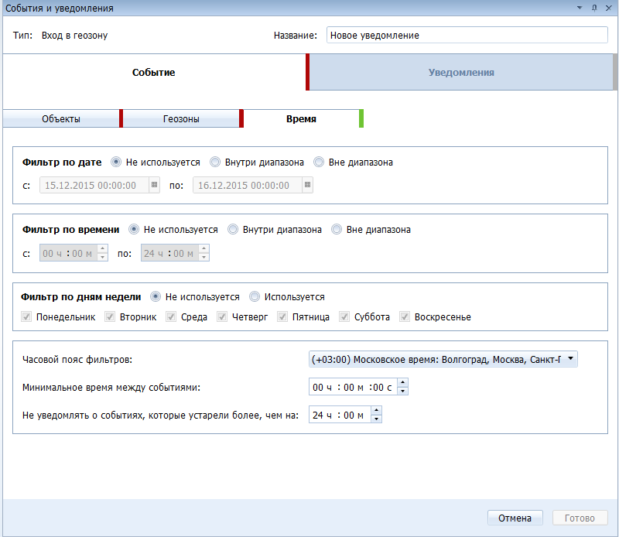
Forth level of control
Automatically sending reports on schedule
Sending reports based on configured templates
Flexible event configuration for notifications
Sending notifications based on configured templates on email

Slide 12

Flexible integration system
With 1C including personally customized versions
With ERP systems on any platform
With carpool planning systems
With your website
With any other system using an open interaction protocol

Slide 13
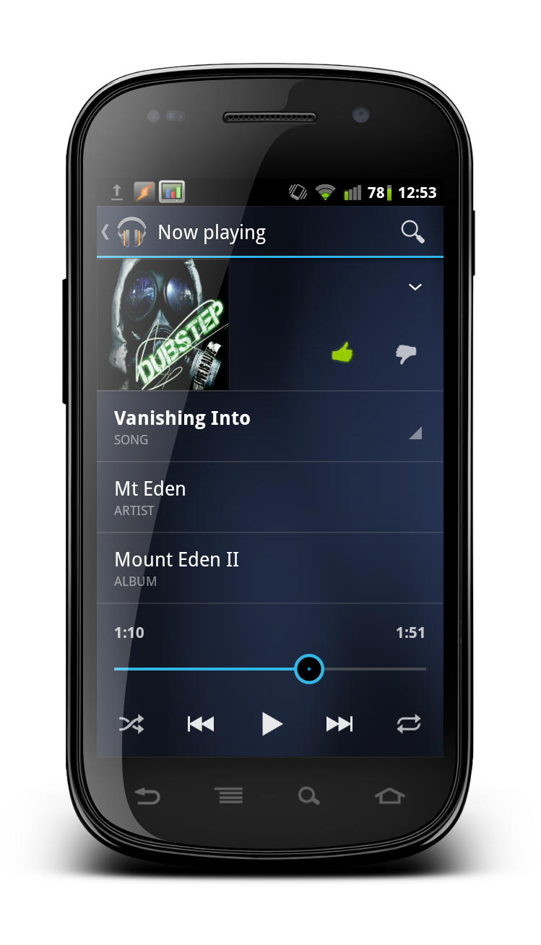


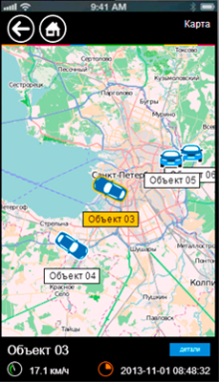
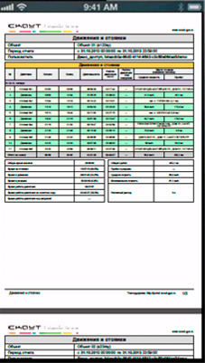
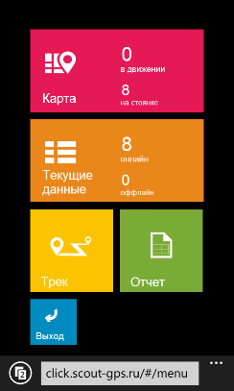



SCOUT-Click: Mobile Interface

Slide 14
Which of my drivers violates the traffic rules?
Solution: Safe driving

Slide 15
Implementation benefits
Reducing the number of accidents involving company’s stuff
Reducing expenses on POL and maintenance, increasing vehicles’ workability
Reducing expenses on vehicle fines, repairs and insurance
Reducing responsibility risks for persons in charge
Payback period: 3 – 12 month

Slide 16
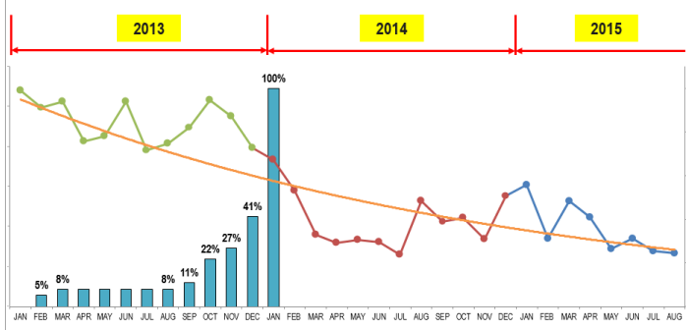
Implementation benefits: PepsiCo company
Road accidents to 1 million km.
>8 000
transport units
25 00
employees
% of equipped vehicles
3,5 times less
car accidents in
less than a year

Slide 17
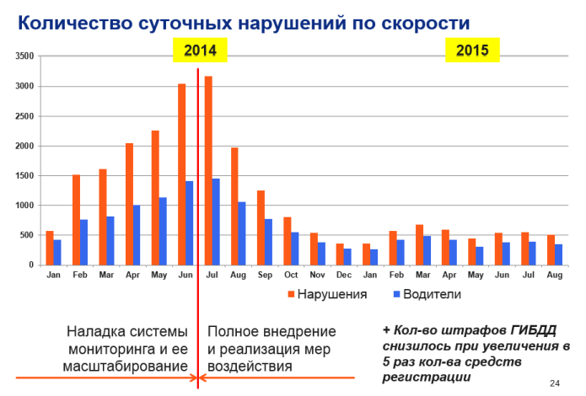
Safe driving solution benefits
Daily speed violations
violations
drivers
Before 100% equipment
After 100% equipment

Slide 18
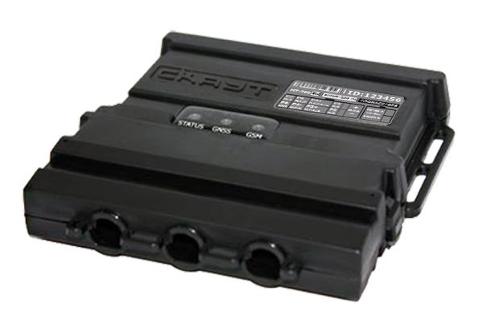
Equipment: Monitoring module with buzzer
Sound signalization device that alerts a driver about dangerous maneuvers
Embedded acceleration and braking sensor
Headlamps and belt use sensor connection

Slide 19
Отчет по Безопасному вождению
Maximum – 100 points
Minimum – 0 points
Good
over 90 points
Satisfactory
from 70 to 90 points
Bad
Less than 70 points

Slide 20
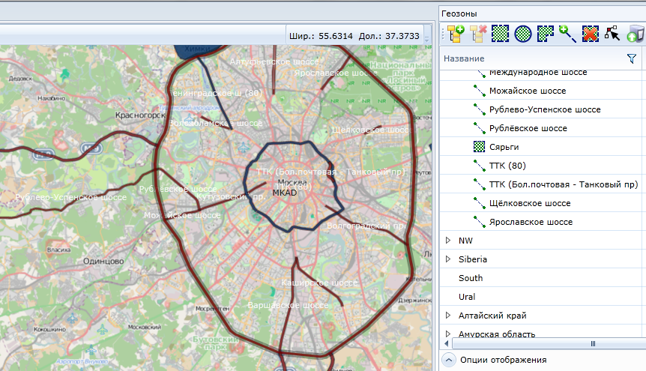
Speed limit
The System considers current speed limits depending on a part of a road

Slide 21
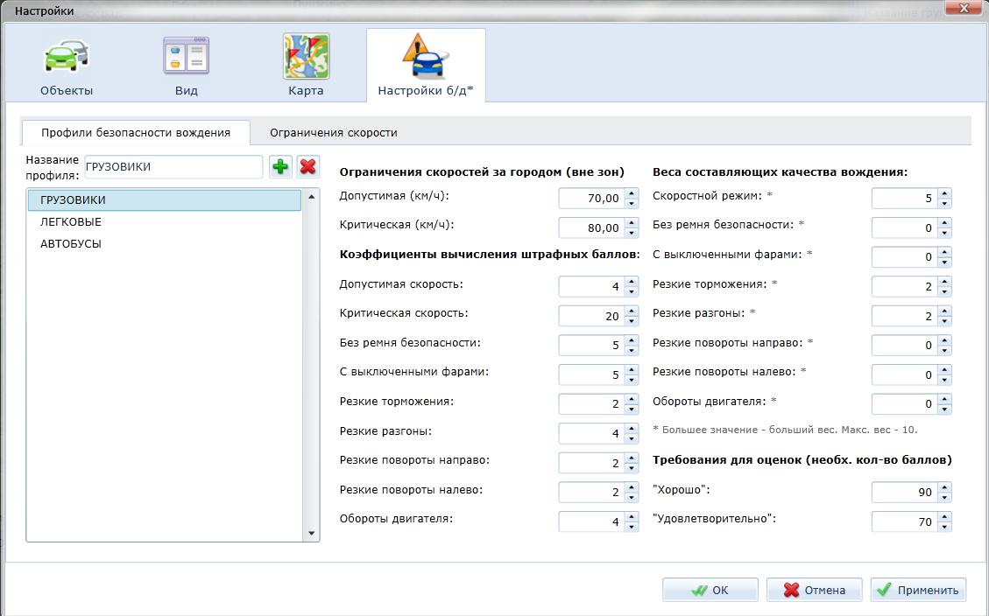
Profiles
Flexible configuration of each violation parameter
Profiles for each vehicle type

Slide 22
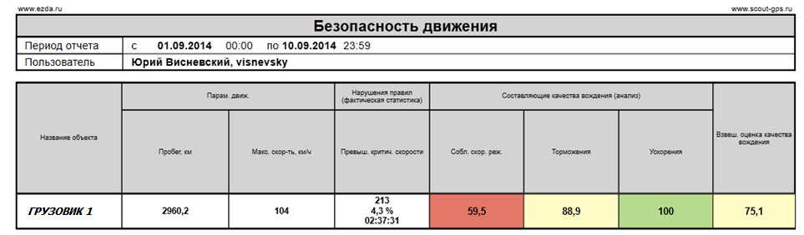
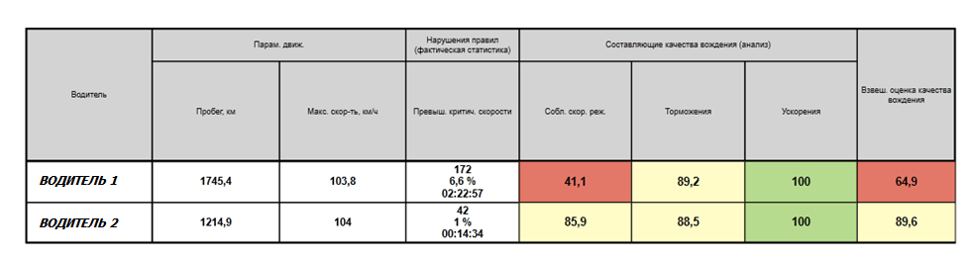
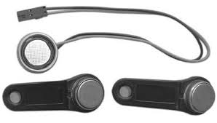
Vehicle and driver reports
Driver identification is done via tachograph integration or additional equipment use
System considers only driver’s violations, not the vehicle’s

Slide 23
Where does fuel disappear?
Solution: Fuel control

Slide 24
Implementation benefits
up to 40%
reduce in vehicle fleet maintenance expenses
Reducing fuel norms and detecting vehicles with increased consumption
Excluding schemes with waybills
Detecting venal fueling and oil discharges
Reducing expenses on POL and maintenance, increasing vehicles’ workability
from 10 to 40%
mileage reduction

Slide 25
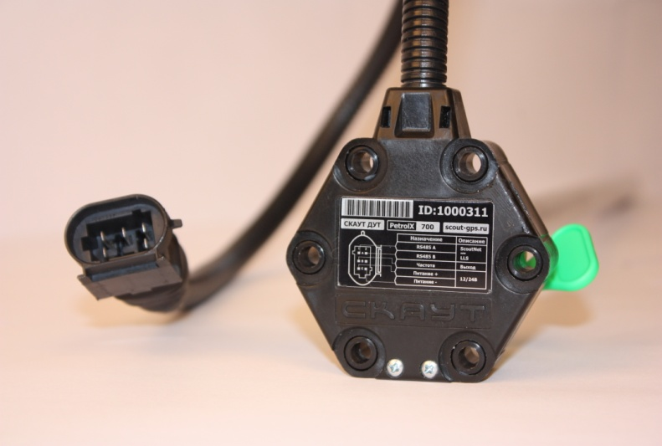
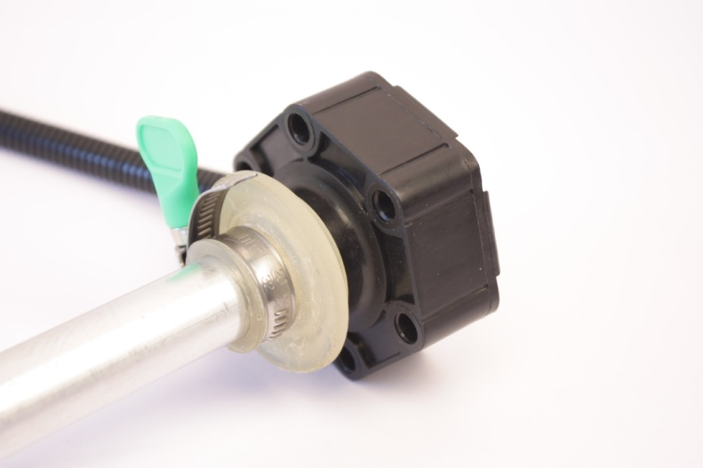
Equipment: Fuel level sensor (FLS)
5-YEAR WARRANTY
Small and durable case and corrugation
It allows to both easily and securely fix the FLS on fuel tanks of the majority of machinery types
Remote configuration and replacement of embedded software
It significantly facilitates system’s maintenance and saves users’ money
Different length variations:
700, 1000, 1500, 2000, 3000 mm
High range of measurable POL
The main petrol brands, summer and winter diesel fuel, other liquid petroleum products that keep their physical state at temperatures from -40 to +80°С

Slide 26
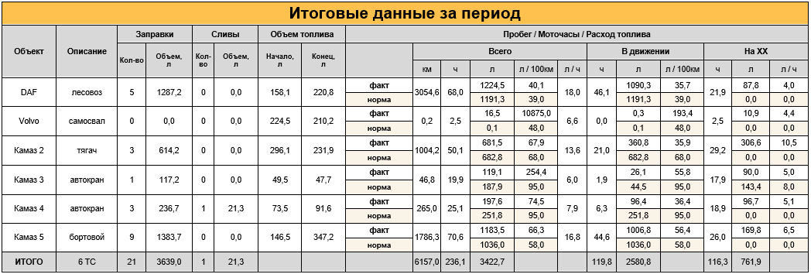
Group report on fueling and discharges
Group report provides a summary on one vehicle as well as on the whole vehicle fleet
For cargo vehicles fuel consumption is calculated on 100 km
Switching to single reports in 1 click

Slide 27
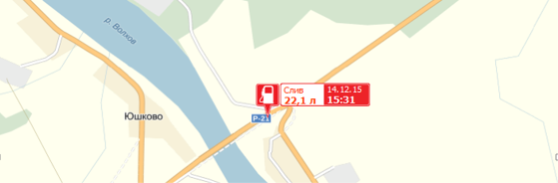
Single report on fueling and discharges
Single report demonstrates a volume of each fueling and discharge for one vehicle
Switching to an event (fueling, discharge) in 1 click

Slide 28
Which way do I avoid fines for non-compliance of labor and rest regime of a driver?
Solution: Tachograph integration

Slide 29
Implementation benefits
Reducing expenses on vehicle fleet maintenance via satellite transport monitoring system
Increasing the efficiency of drivers’ labor and rest regime compliance control
Compliance to legal requirements without stopping production processes
up to 15%
vehicle fleet maintenance expenses reduction
up to 30%
decrease in the number of violations of labor and rest regimes of drivers
Payback period: 3 – 12 month

Slide 30
Equipment: Tachograph
Tachograph is an additional source of information for a monitoring module which transfers the following data:
driver’s identification
appropriateness and use of a tachograph
driver’s compliance to labor and rest regime
allows to automatically unload ddd-files

Slide 31
«Drivers’ trips» report
Uses identification via driver’s personal card, inserted in a tachograph
Operates in two regimes:
Which drivers controlled selected vehicles
Which vehicles were controlled by selected drivers

Slide 32
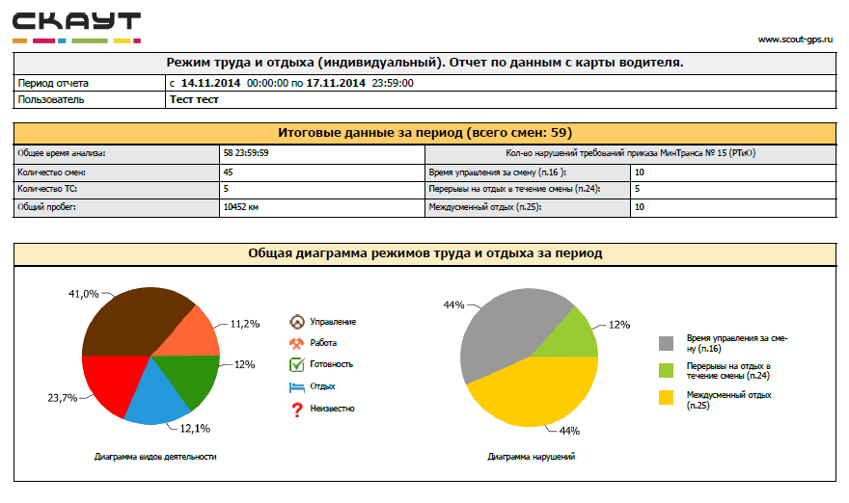
«Drivers’ labor and rest regime» report
Group and single reports on label and rest regimes
Report might be based on unloaded ddd-files
For drivers without tachographs report might be made according to mobile terminal data

Slide 33
«Drivers’ labor and rest regime» report

Slide 34
How did my excavator operate today?
Sulution: Special machinery control

Slide 35




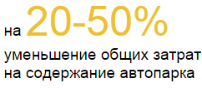

Implementation benefits
Allows to avoid long-term demurrage at idle speed and increase service intervals
Payment only for actual operating time
Increasing machinery’s reliability of operation and resource
Compliance to regulatory conditions of exploitation and technical support
from 20 to 40%
fuel expenses reduction
20-50%
vehicle fleet maintenance expenses reduction

Slide 36

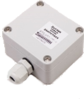
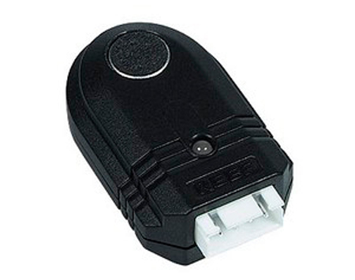
Equipment: additional sensors
Engine activity sensor
Is designed to control engine speeds in special machinery. Data received from sensors allows to account engines’ service life accumulation.
Mechanism position sensor
Is designed to control special machinery. It is installed on a mobile part of a vehicle and registers a fact of activity as well as its position which allows to control the efficiency of machinery’s use and, as a result, reduce expenses on its maintenance.
Small movements sensor
Is designed to control special machinery. It is installed on a vehicle in order to detect small movements that cannot be identified by GPS/GLONASS

Slide 37
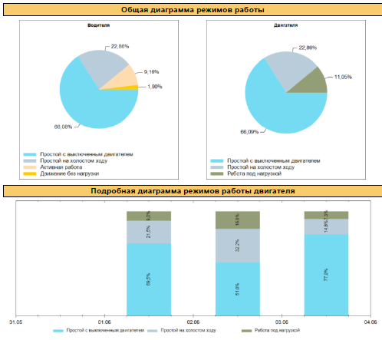
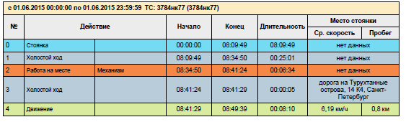
«Fueled machinery’s activity modes» report
Engine activity modes diagram
Driver’s activity modes diagram
Detailed description of each motoperiod

Slide 38
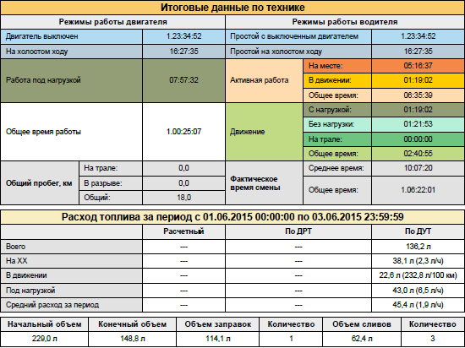
«Fueled machinery’s activity modes» report
Detailed summary on machinery’s operating modes
Data on fuel consumption under pressure and at idle speed
Volumes of fuelings and discharges
Driver’s operation period

Slide 39
How does my fueler operate?
Solution: Fueler control

Slide 40
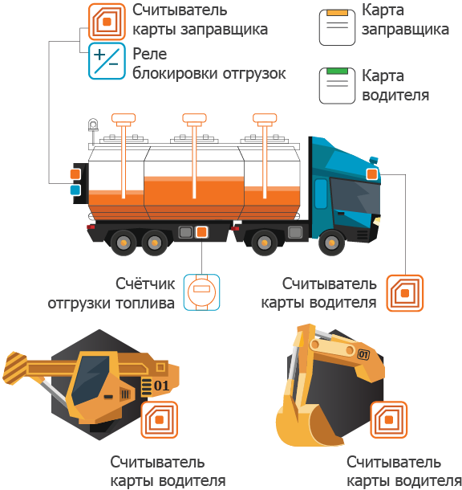
Solution’s capacities
Fueler’s card reader
Fueler’s card
Unloadings locking relay
Driver’s card
location and transport activity control
ATZ tank fueling/discharge
fuel unloadings via driver’s card control
fuel unloadings via fueler’s card control
Fuel loading meter
Driver’s card reader
Driver’s card reader
Driver’s card reader

Slide 41
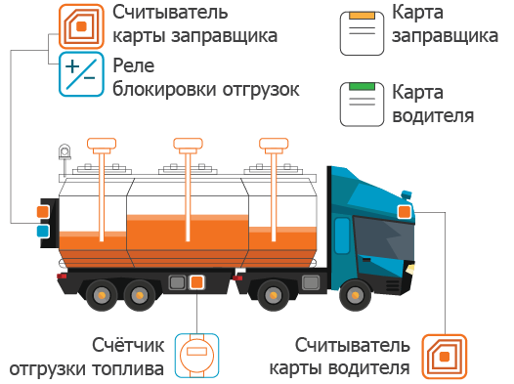
Implementation benefits
Fueler’s card reader
Fueler’s card
Unloadings locking relay
Reducing fuel expenses
Driver’s card
Increasing efficiency
Increasing discipline
Fuel loading meter
Driver’s card reader

Slide 42
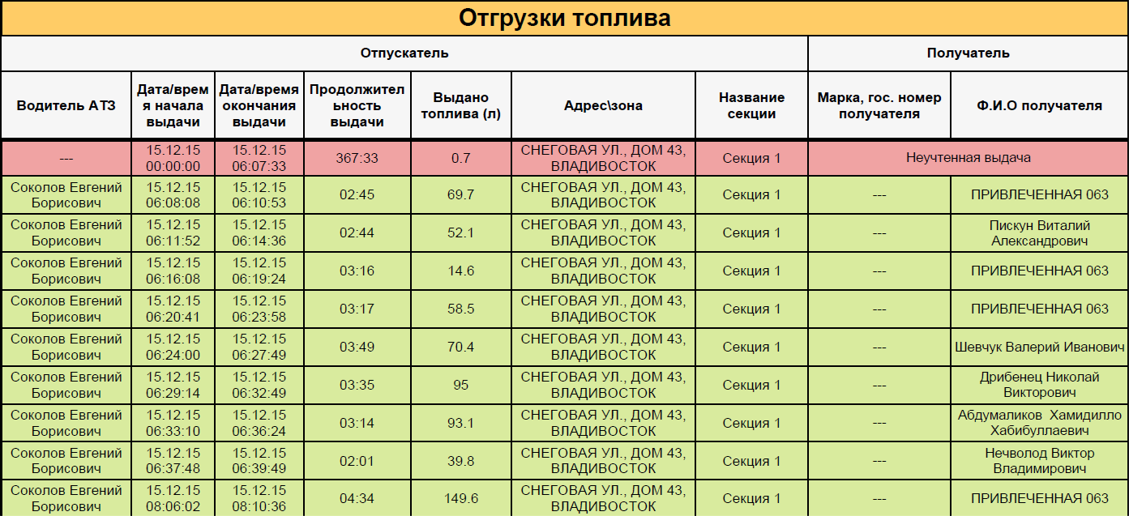
Refueler labor report
Accounting of each fuel gain with volume and recipient information

Slide 43
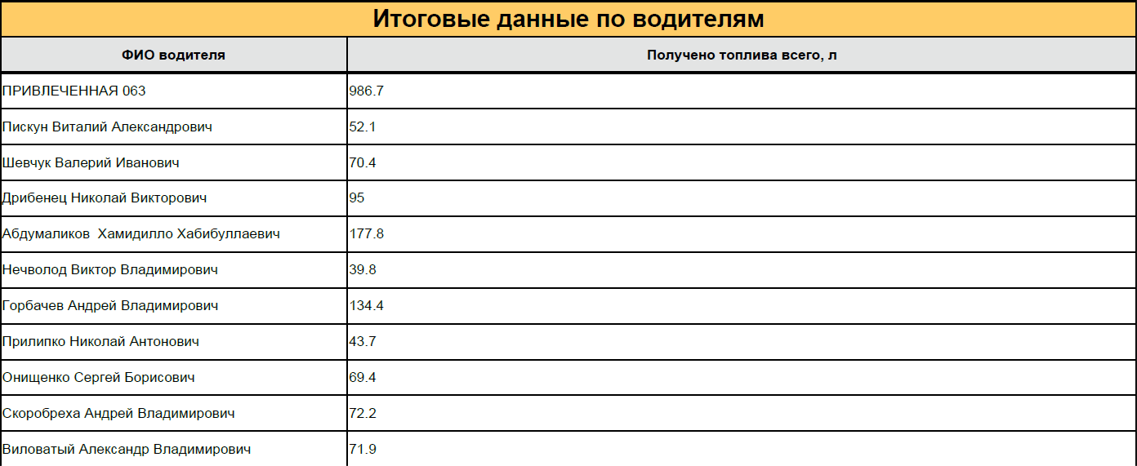
Fueler labor report
Summary volume of fueling for each driver

Slide 44
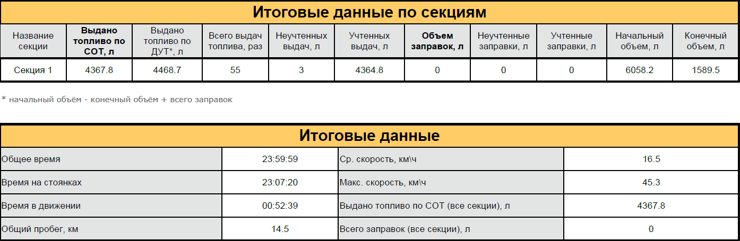
Fueler labor report
Summary data on the reporting period

Slide 45
How do I return a stolen vehicle?
Solution: Stolen vehicle search

Slide 46



Implementation benefits
Increasing the probability of cars’ returning in case of a carjacking
Reducing the amount of time spent on searching for lost objects

Slide 47
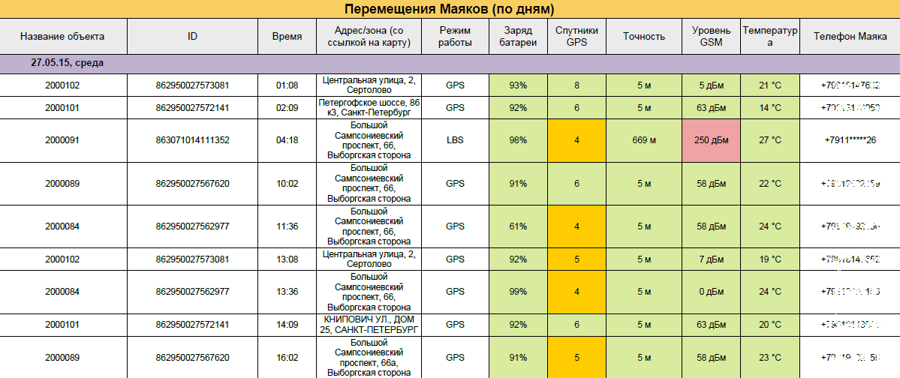
Report examples

Slide 48
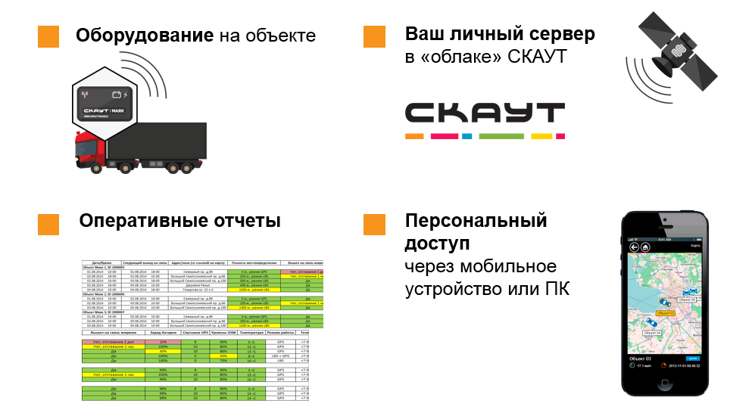
«Stolen vehicle search» solution benefits
Equipment on the object
Your own server
located in SCOUT cloud
Personal access
Via mobile device or PC
Operational reports

Slide 49
COMPANY FLEET
SOLUTIONS
96
Basic monitoring of transport
For decreasing expenses on vehicle fleet
trucks
Service «Custom development»
Gazelle, Iveco, Isuzu, Volvo, Man, Scania
Integration with Microsoft Dynamics
RESULT
REVIEW
FUEL SAVING:
Implementation of the System SCOUT certainly has a positive effect on our work. It not only just provides an opportunity to operative fuel control, places of parking and speed limit control. Today it’s a valuable integrated toolbox for Logistics Services, as well as Finance and Administrative departments of a Company.
Dina Bolotina,
Head of Development Unit in Saint-Petersburg, Development Department,
Directorate of internal Logistics , OSC Distribution.
19%
11%
SUMMER SEASON
WINTER SEASON

Slide 50
COMPANY FLEET
SOLUTIONS
>8000
Driving Safety
For reduction of the number of traffic accidents
Basic monitoring of transport
For decreasing expenses on vehicle fleet
vehicles
Machinery Control
For cutting the downtime
Integration with tachographs
For cost recovery
Passenger: Reno Sandero, Reno Logan, Ford Focus
Trucks: Volvo
Services: «Custom development» and «Analytics»
RESULT
REVIEW
3,5 times
Flexibility and service culture are the main qualities of SCOUT Group of Companies in handling with corporate clients. Collaboration between our companies is getting deeper on an equal basis with appearance a new functional and different kinds of accounts in the System SCOUT. Now the System have been using successfully by our staff members of Logistics, Delivery and Transport departments.
Vladimir Leontenkov,
Fleet Safety Manage PepsiCo Russia and CIS
Reduction of the number of traffic accidents
in less than a year

Slide 51
COMPANY FLEET
SOLUTIONS
>50
Basic monitoring of transport
For decreasing expenses on vehicle fleet
vehicles and special machinery units
Fuel Control
For reduction of fuel expenses
Gasoline tankers, transit-mix trucks, bolster-type
tractors, dump trucks, loaders, truck cranes, bulldozers, tractors, passenger cars and minibuses
The implantation of the System SCOUT was made by our certified partner «Glonass-Navigator» company.
RESULT
REVIEW
42%
«Neftika» company has got instrument for monitoring of transport and special machinery. Unauthorized discharge of fuel, diversion work and machine time loss were excluded in our company by now. Due to fuel saving, we have increased profitability of business and have the opportunity to direct saving money on development.
Igor Vlasenko,
Lead Manager of GK «Neftika»
Fuel consumption decreased
20%
Expenses on specialized vehicles reduced

Slide 52
TASKS
SOLUTIONS
to fix the volume, time and places of fueling and defueling
to analyze fuel consumption
to track the routes of transport movement
to control work of objects in real-time
Basic monitoring of transport
For decreasing expenses on vehicle fleet
Fuel Control
For reduction of fuel expenses
RESULT
REVIEW
ECONOMY PER YEAR
It is important to note that this System makes it possible to control and make operative decisions for optimizing work of our transport. Dealing with the System
is comfortable and effective, service and technical support–qualitative and well-timed.
OOO«DorStroy» representatives
15 000 – 19 000
liters of fuel
500 000 – 600 000
rubles

Slide 53
COMPANY FLEET
SOLUTIONS
15
Basic monitoring of transport
For decreasing expenses on vehicle fleet
vehicles
Fuel Control
For reduction of fuel expenses
Gazelles and private cars of staff
Searching over car theft
For returning stolen car
RESULT
REVIEW
During the time of using this solution we haven’t had yet carjacking accidents. However, we know that we have a big chance to return our vehicles, by setting markers and software. Argument in favour of choosing «Searching over car theft» solution is fact that SCOUT Group of Companies is its developer. We’re exploiting the system of satellite monitoring of this manufacturer for a long time and can be sure in high-quality of all company’s products.
Alexey Efimov,
logistics specialist
Optimization of cargo delivery
Exclusion of deflections from the route
Increasing of chance to return the car in case of carjacking

Slide 54
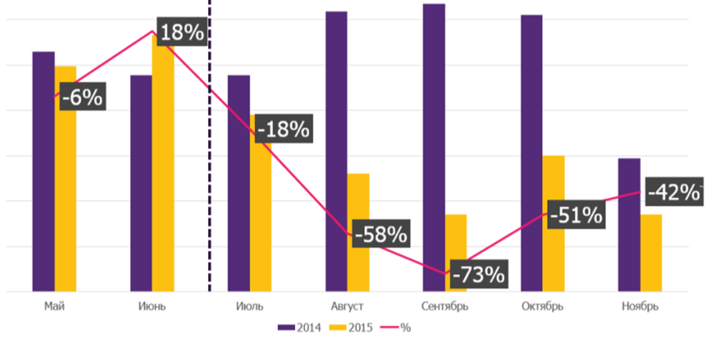
COMPANY FLEET
SOLUTIONS
>40
Basic monitoring of transport
For decreasing expenses on vehicle fleet
vehicles
Fuel Control
For reduction of fuel expenses
Among equipped transport:
GAZ, KAMAZ, HAMM, MAN, VOLVO
RESULT
REVIEW
before equipment
after equipment
Reduction of fuel consumption by 20-30% had already been recorded at the build phase. And after a whole vehicle fleet equipment economy have been reached by 50-60% per month, in comparison with similar periods of previous year. We have identified at once employees, involved in fuel fraud, and prevented any reoccurrence of such situations.
Vladimir Lapin,
Head of production base, «Hermes»
Monthly fuel consumption

Slide 55
COMPANY FLEET
SOLUTIONS
>50
Basic monitoring of transport
For decreasing expenses on vehicle fleet
vehicles and special machinery units
Fuel Control
For reduction of fuel expenses
Dump trucks KAMAZ 65115 and 64115,
Tractor units MAZ 6422208 and VOLVO FM, bulldozers LIEBHERR PR, excavators JSB JS220, motor graders DZ-98, lorries MAZ -6430 and GAZ- 3309
Machinery Control
For reduction of demurrage
RESULT
REVIEW
10%
As a result of installation the System SCOUT we have got a full control for our transport sector. System allows to exclude deflections from the route, prevent misuse of vehicles and unauthorized discharge of fuel. In general because of exact and reliable control fuel expenses have been decreased by 10%.
Sergey Pavlov,
Deputy General Director
fuel consumption decreased
5
dispatcher workplaces were created

Slide 56
COMPANY FLEET
SOLUTIONS
75
Basic monitoring of transport
For decreasing expenses on vehicle fleet
vehicles
Fuel Control
For reduction of fuel expenses
The implantation of the System SCOUT was made by our certified partner, «Satellite» company.
RESULT
REVIEW
In the first months of the System SCOUT use in EFKO GROUP vehicle fleet there was reported:
mileage decreasing
reducing the Number of vehicle misuse
improving the discipline of employees
25 vehicles first had been installed. And then, appreciating all values of this System, we equipped further 50 vehicles. In spite of the fact, that cars are constantly on business trips, CSM
«Satellite» employees ensured installation of monitoring equipment as soon as possible. We wish to point out their efficiency during the time of transport equipment and in handling issues related to process of using the System SCOUT as well.
Roman Roshupkin,
Logistics Director, MSD EFKO GROUP

Slide 57
TASKS
SOLUTIONS
Enterprise has extensive dealer network and a lot of distant selling points.
By the middle of 2013 year, along with business growth and vehicle fleet widening, a need for strict traffic control has become obvious for the company.
Basic monitoring of transport
For decreasing expenses on vehicle fleet
Fuel Control
For reduction of fuel expenses
The implantation of the System SCOUT was made by our certified partner «Perviy BIT- Samara»
RESULT
REVIEW
As a result of connecting to GLONASS/GPS-monitoring system, we have a clearer view of current vehicles location that makes it possible to avoid force majeure situations during transportation. It is possible to get an exact mileage and fuel consumption information. It has reduced transport charges up to 15-20%.
Shumakov A.S.
Director OOO «RK «Akvatoria»
15-20%
Transport charges reduce

Slide 58
COMPANY FLEET
SOLUTIONS
30
Basic monitoring of transport
For decreasing expenses on vehicle fleet
vehicles and special machinery units
Fuel Control
For reduction of fuel expenses
Machinery Control
For reduction of demurrage
Passenger cars and trucks, special machinery and diesel power plants
The implantation of the System SCOUT was made by our certified partner «Perviy BIT- Samara»
RESULT
REVIEW
35%
By virtue of Implementation of the System SCOUT we were able to reduce fleet maintenance costs significantly. Now we understand clearly that happens with each vehicle at any time.
Ruslan Abzibarov,
transportation engineer «NefteHimPromPovolzhye»
fuel consumption decreased
5
dispatcher workplaces were created

Slide 59
COMPANY FLEET
SOLUTIONS
125
Basic monitoring of transport
For decreasing expenses on vehicle fleet
heavy-duty trucks
Fuel Control
For reduction of fuel expenses
Machinery Control
For reduction of demurrage
15
5
passenger cars
special machinery units
The implantation of the System SCOUT was made by our certified partner «AutoControlService»
RESULT
REVIEW
The work on the implementation of the System was made by our specialists from May to September of 2014 year. MT-600 285 PRO monitoring modules and fuel level sensors were installed on transport. Ten dispatcher workplaces with SCOUT software were created. Installation work have been held qualitatively and strictly in time with minimal distraction of transport from chief work.
Albert Makienok,
Director OOO «AutoControlService»
ECONOMY PER MONTH:
1 000 000
rubles

