Slide 1

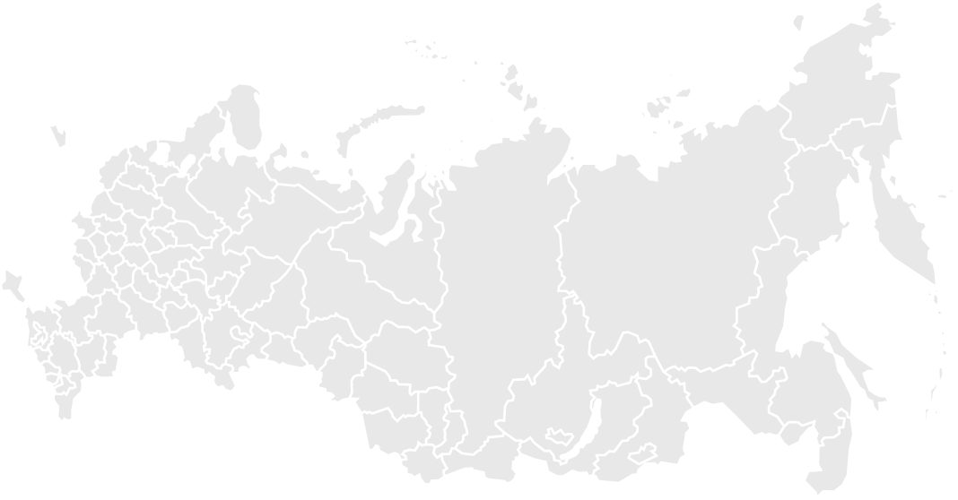

Satellite monitoring, fleet management and analytics
Integrated solutions for fleet management issues based
on GPS and GLONASS technologies

Slide 2
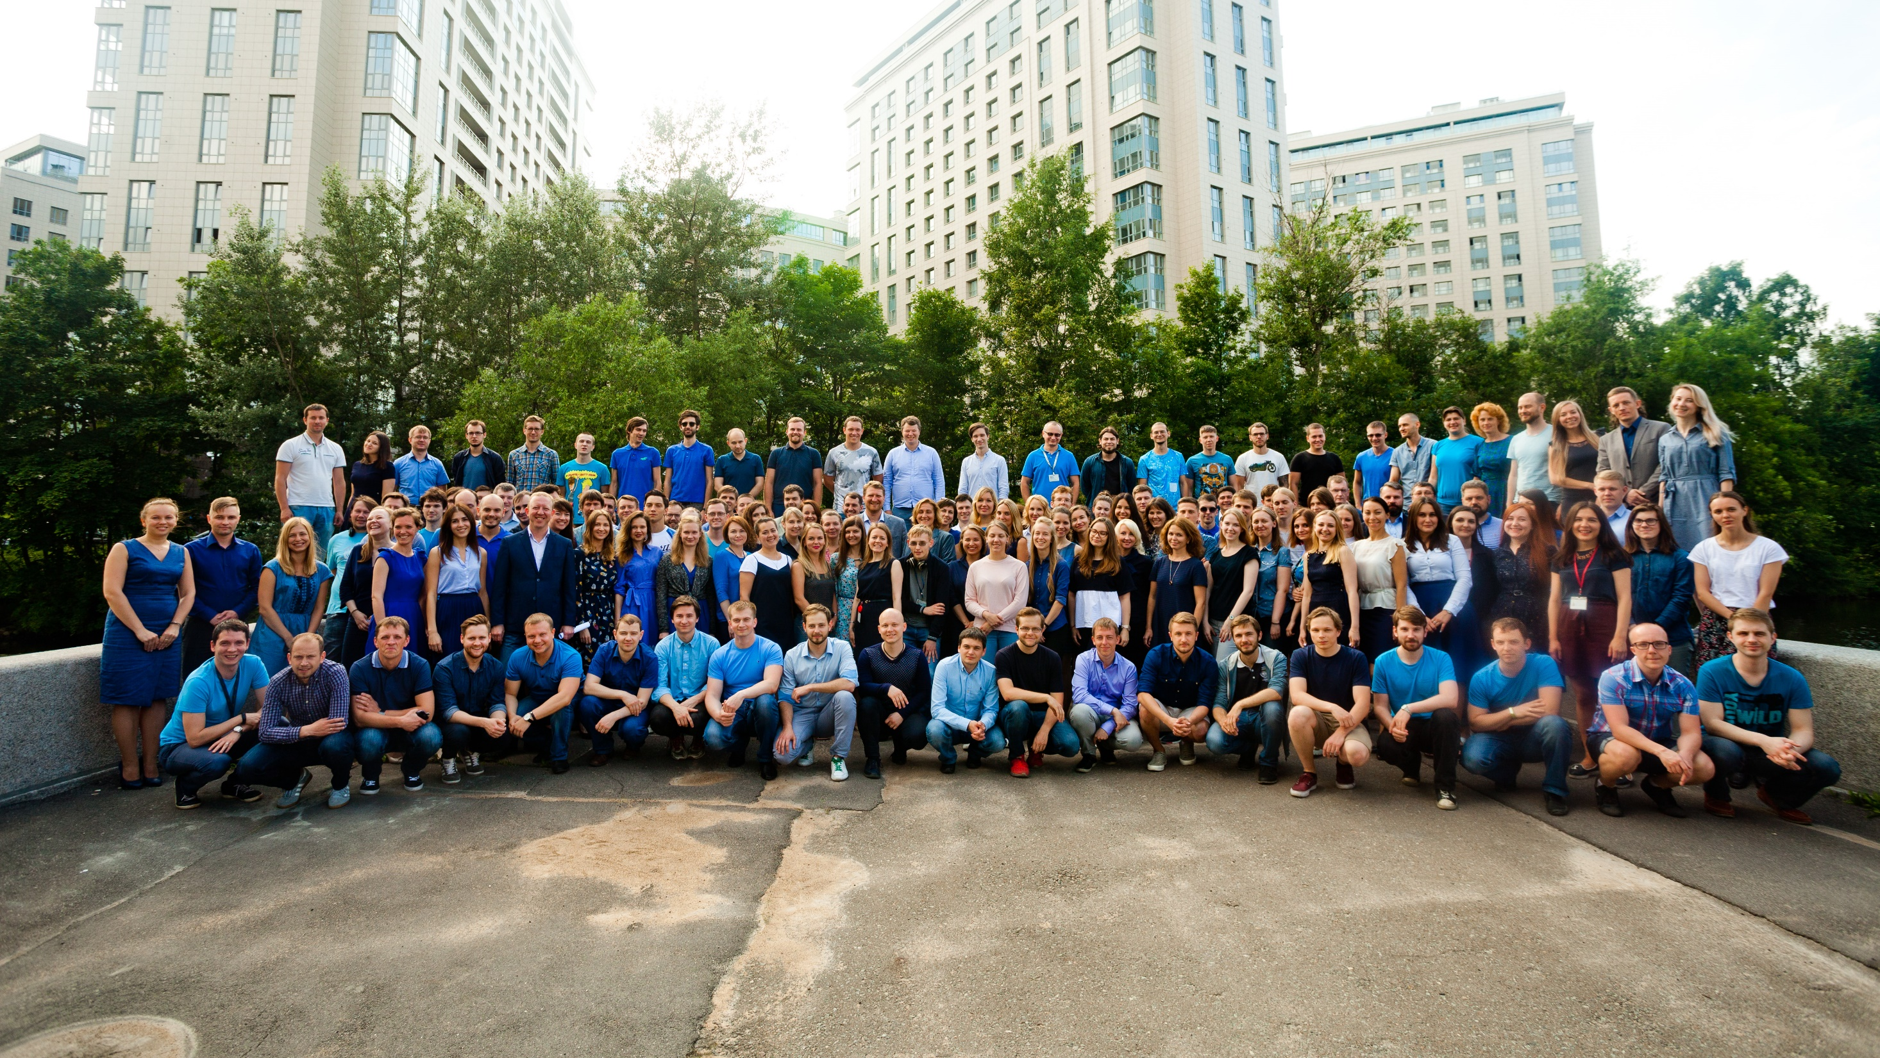


190m
employees
+
One of the best GTS suppliers in Russia and CIS countries

Slide 3

Complete
fleet management solution
Cloud Platform
Tracker, fuel sensor
additional equipment development and manufacturing
Analytical center
Client
300+ DISTRIBUTORS
on Russian market
24/7
technical support

Slide 4

SCOUT Solution
Tracker + additional sensors
Analytic software and reports

Slide 5









customers
equipped vehicles
cloud platform objects

Slide 6



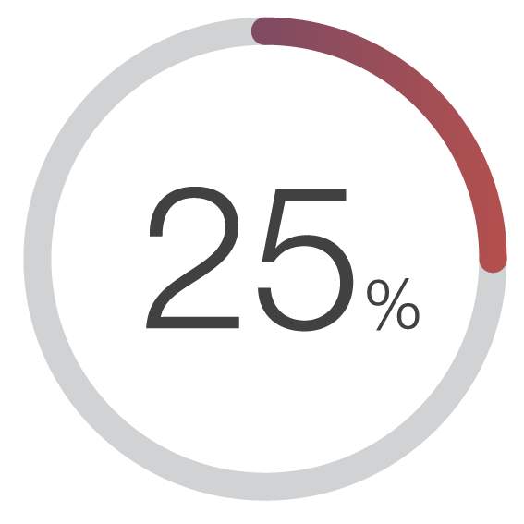
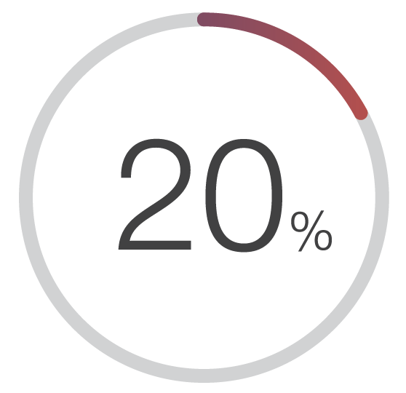

COSTOMERS RESULTS
According to the survey of 2017
times less road accidents with company’s fleet
less monthly mileage for each equipped vehicle
less fuel expenses

Slide 7

SCOUT History
Development start
The first major project: 500 vehicles
Launch of official web-site www.scout-gps.ru
Partners learning programs
Industry solutions
Web-interface
«RUSSOFT» industry partnership
Active participation in industry exhibitions
4 employees
in company staff
30 employees
in company staff
41 distributors
dealer network
90 employees
in company staff
More than 100 distributors
Russia and CIS
2005
2008
2012

Slide 8
Custom Software Development
TOP-5 Russian vendors of monitoring systems
Release of new tracker series МТ-700
Solution «Integration with tachographs»
Safe Driving Solution
Corporate education center «SCOUT-Academy»
New solution «Economic driving»
New global clients:
BIOCAD, Imperial Tobacco, Roche, Rockwool etc
New Web-interface - «SCOUT-Online»
150 employees
in company staff
More than 140 distributors
Russia and CIS
180 employees
in company staff
More than 200 distributors
Russia and CIS
190 employees
in company staff
More than 366 distributors
Russia and CIS
2014
2016
2017

Slide 9
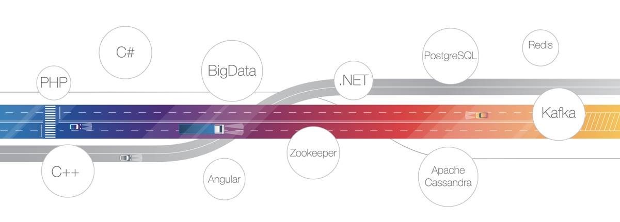
Software Technology Stack

Slide 10



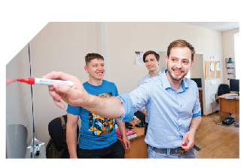
SCOUT Services
Custom development
• personal project team
• client’s business process
aspects accounting
Technical support
• 24/7
• SLA
• Service Portal
Individualized reports
• personal dispatch service
• reports upon request
Training:
• free of charge
• internally / remotely

Slide 11


OWN CLOWD PLATFORM
• 99,7% of system accessibility
• easy connection of new objects (including third-party devices)
• most relevant software version available permanently
• full set of reports and plugins to deal with client’s business tasks

Slide 13

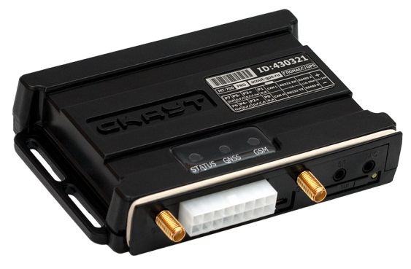
SCOUT МТ-700 series
tracker

Slide 14

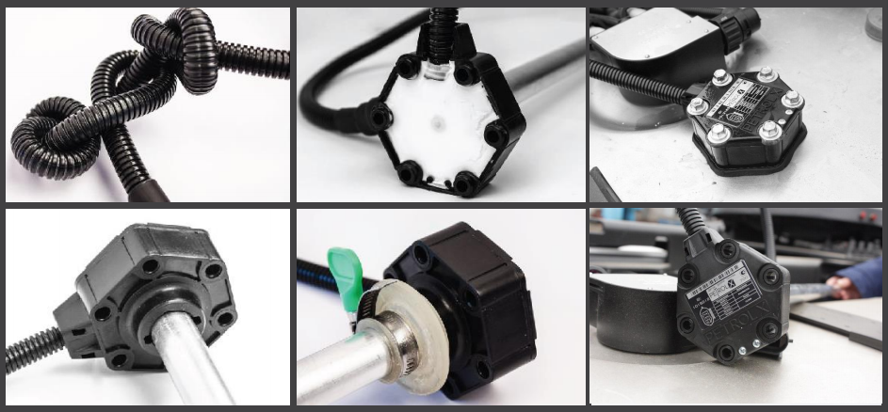
PetrolX fuel level sensor

Slide 15
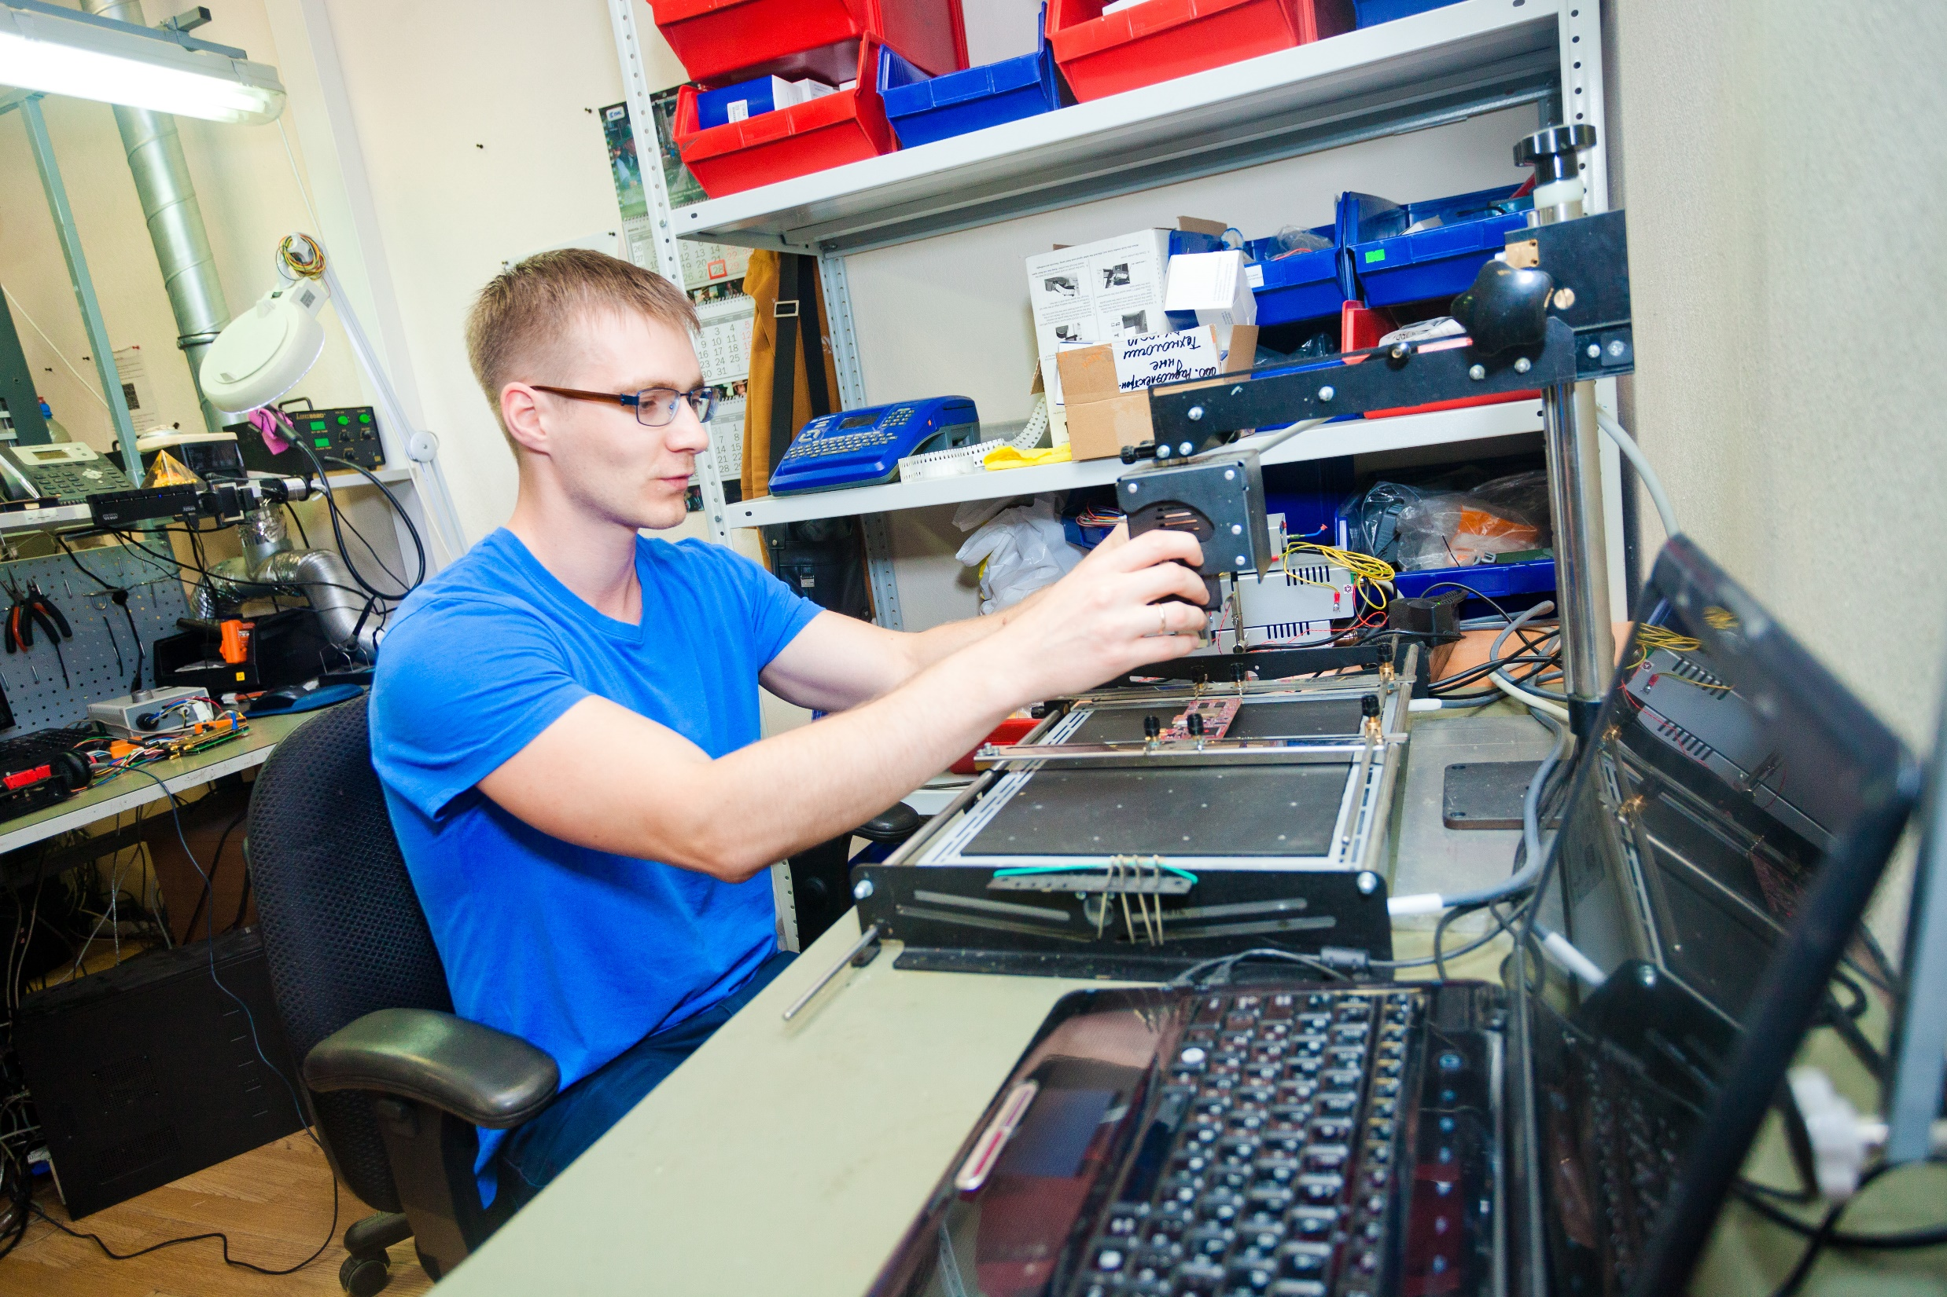
PRODUCTION AREA

Slide 16
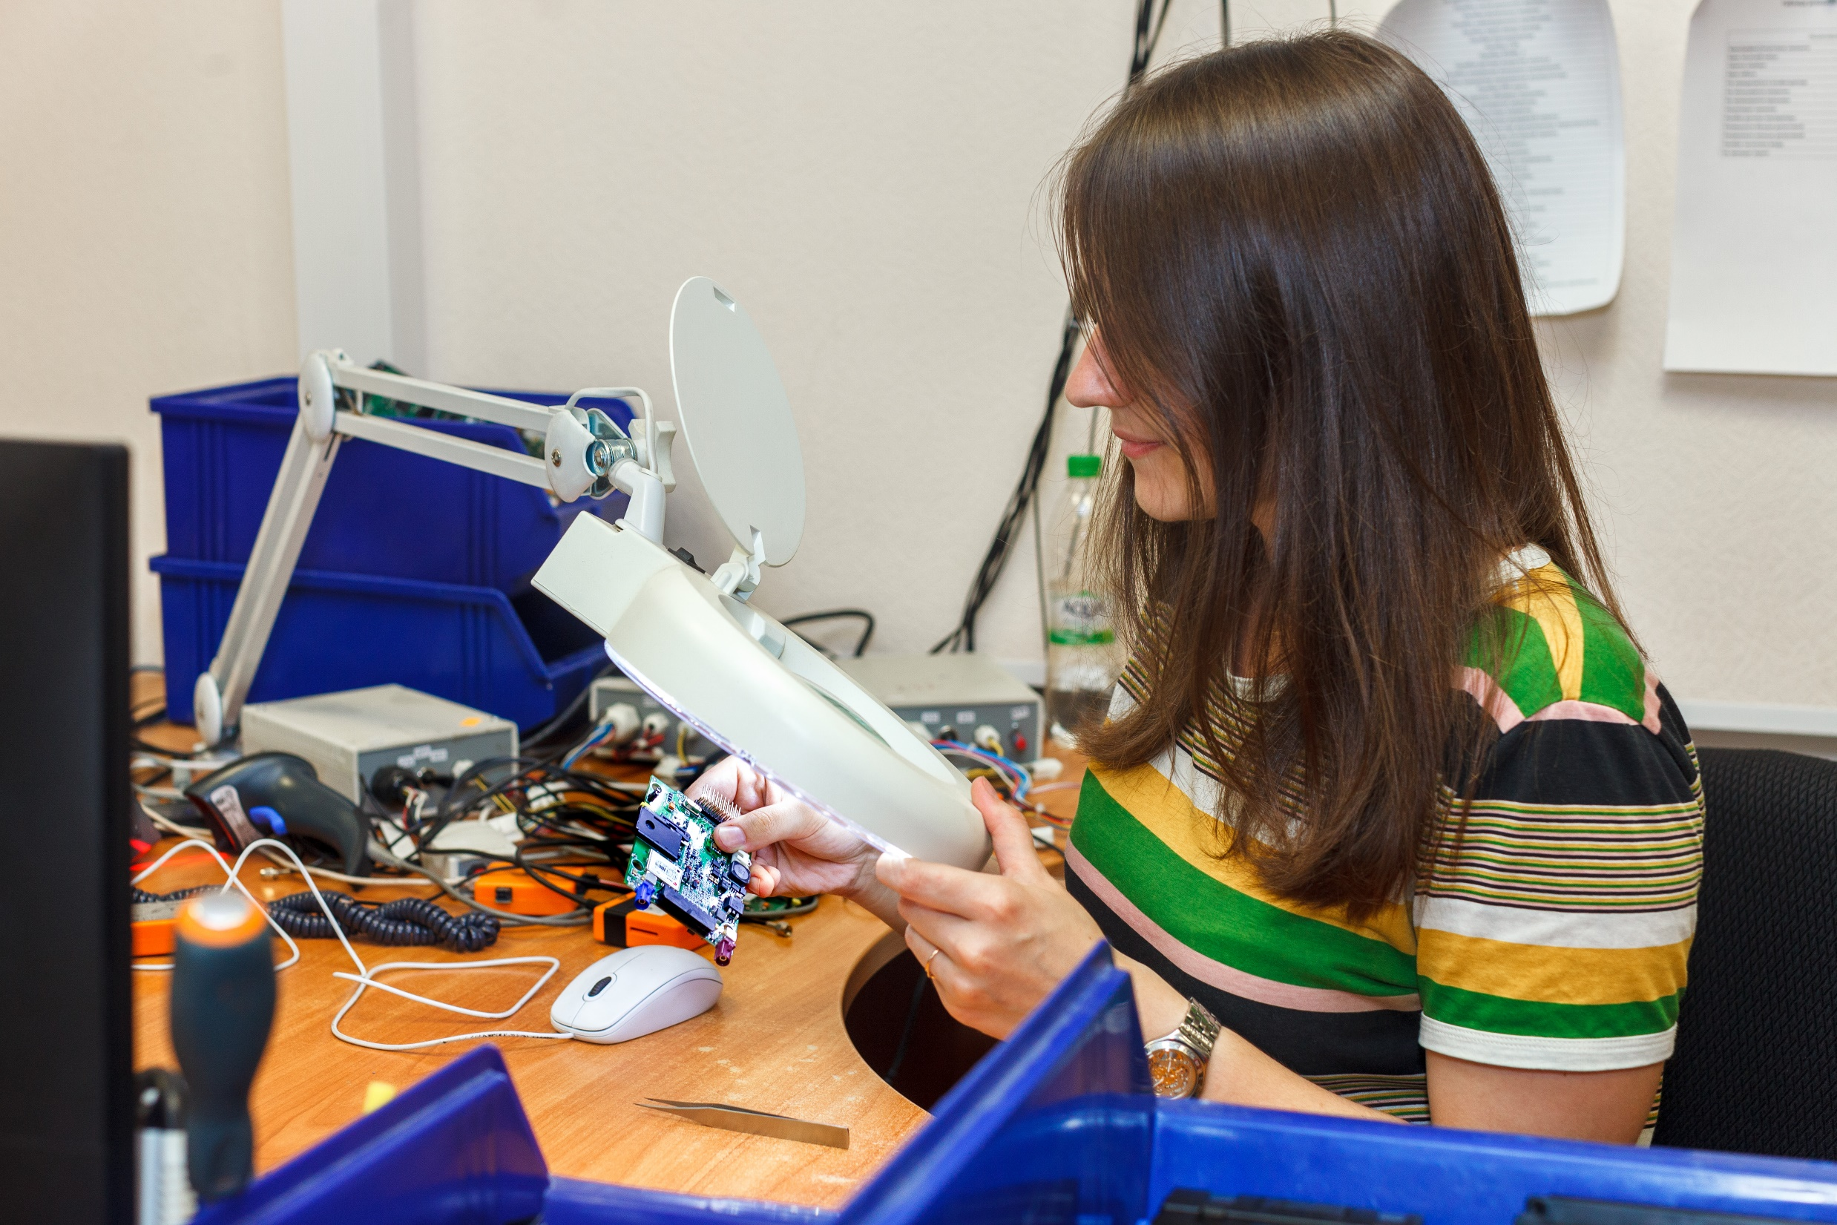
QUALITY CONTROL

Slide 17
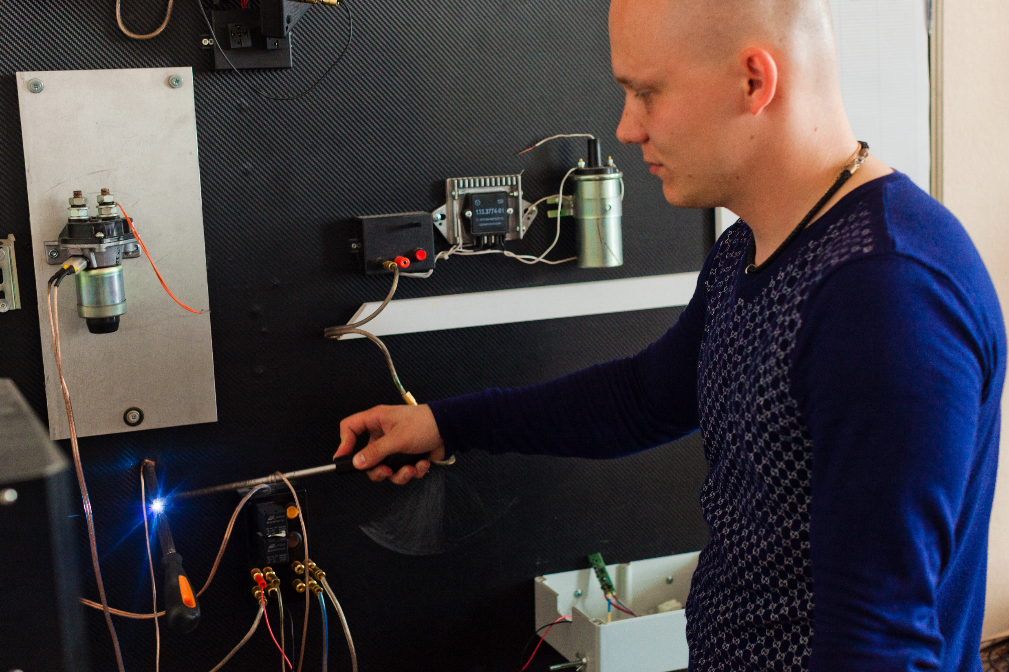
TEST STAND

Slide 18

SCOUT Distributors network
North-West FD
Ural FD
Far Eastern FD
Crimean FD
Central FD
Privolzhsky FD
Southern FD
Siberian FD
North Caucasian FD
Federal network
356
Distributors in
Russia and CIS
FD

